Slide 1


Information technology in
Ayurveda

Slide 2

What is Ayurveda?
Ayurvedic medicine is one of the oldest medicine systems in the world and reamins India's traditional health care system. Ayurvedic treatment mainly combines product mainly derived from plant, animal,metal , mineral,diet, lifestyle and exercise

Slide 3
What is technology ?
We need information technology in today's world to establish faster communication, maintain electronic storage and provide protection to records. In a simple way, IT makes a
system of electronic storage to provide protection for the
re_{h}co_{e}rd_{a}s._{ding}
esetsatbablilsishh ffaasstteer r

Slide 4
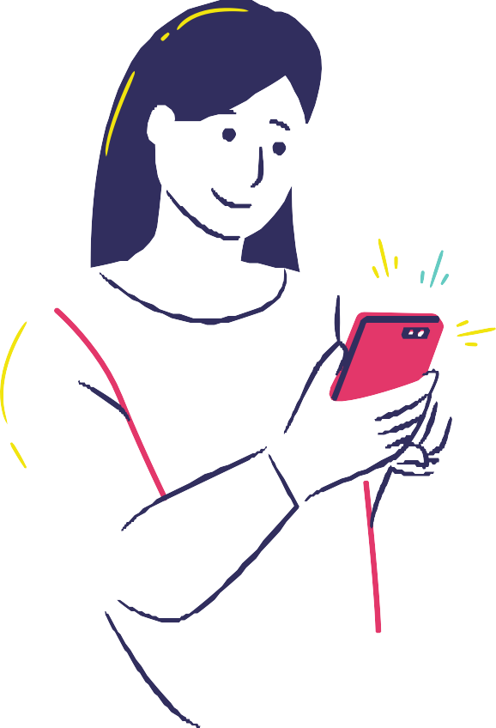
Use of technology in ayurveda :
*Use of technology in traditional system particularly in ayurveda will be beneficial in many
directions .
* This is useful not only for patients and also for health care professional .
*technology will facilitate delivery of ayurvedic healthcare services , standardization and health control.

Slide 5
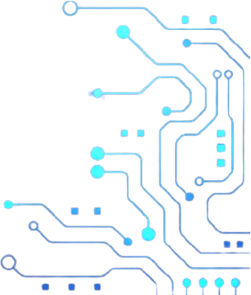
* We need computer for data as entry, data processing and data storage where the data can be retrieved as and when necessary

Slide 6
Technology used :
1 .HTS
High throughput screening
It is used in success for screening plants for new lead compound from herbs

Slide 7
2 . HIT
Health information technology
This technology equips health care professionals with required information and tools for quality precision patient care

Slide 8
3 . THE AYUSH HEALTH
PORTAL
Acts as knowledge base repository that. Allow researchers and academician and students to update their knowledge in the field of ayurveda

Slide 9
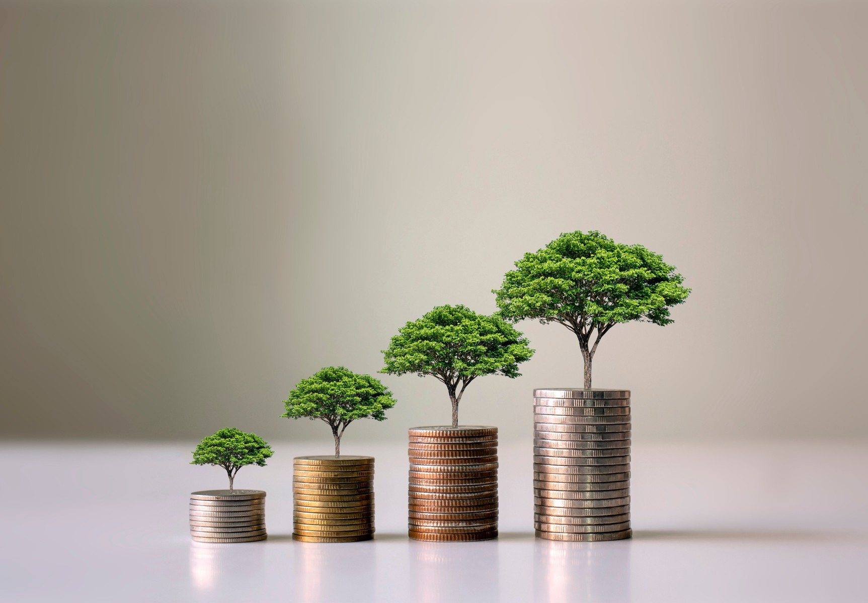
Development in the field of ayurveda
1 . Integrated clinical decision support systems ( software)
This is being developed by.
NIIHM ( Hyderabad)

Slide 10
S. Narayana , Director, NIIHM
In 2008 we brought out an ayurvedic encyclopedia which had scientific meanings of 3000 words . During the course of working on this project we have digitised most of our
research work .An e-book titled charakasamhitha was the by-product of the earlier project
This two projects gave thoughts for rising this software , which is going to be a very useful tool
for doctors

Slide 11
ADVANTAGES

Slide 12

* helps to track medical records .
* easy to access information .
* helps to . track modern problems .
* improve . the quality of health care .
* makes collection and accessibility of patients data record much easier than paper records .

Slide 13
DISADVANTAGES

Slide 14
* Invades the privacy of patients
* We become more dependent to technology
* Technical issues can cause major issues
* Rural areas can't afford technology as cities do

Slide 15

AYURVEDA
It teaches us to cherish our innate -nature "To love and honour who we are" and not
as people think or tell us , "who we should be "
- Prana Gogia

